Slide 1
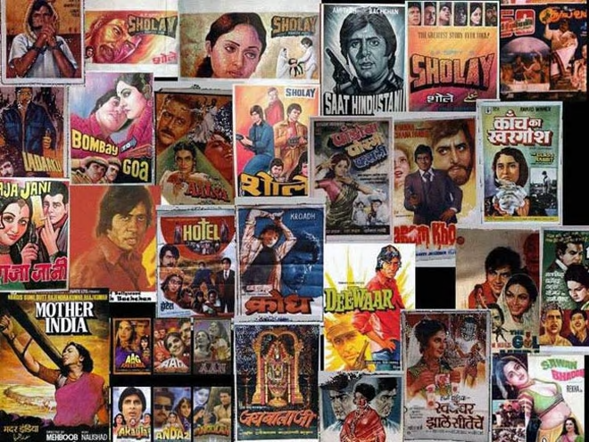
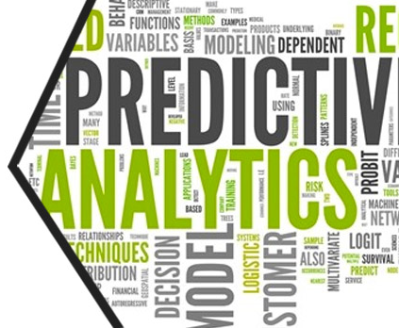
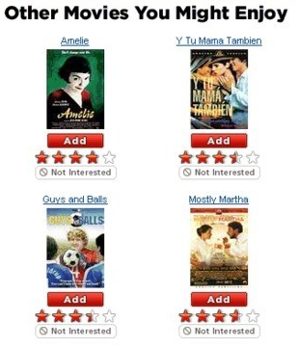
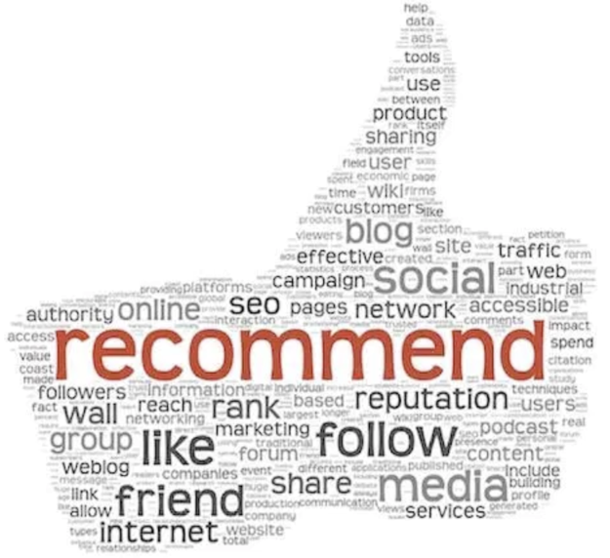


Data Science & Machine Learning
Capstone Project (2nd – 17th March 2019)
“Propensity to watch a video in the next 2 days”
> By
Clyde Mendonca
Krupa Shah
Pranav Nair
Rushabh Mehta
Rajesh Brid

Slide 2
DS & ML – Capstone Project “Audience segmentation of a content app, based on its user’s propensity to watch a video in the next 2 days.”
INDEX
Problem Statement
Dataset Features
Solution Overview
Data Exploration, Features Engineering & Selection
Building Recommendation Engine
Conclusion

Slide 3
Capstone Project : Problem Statement
Problem Statement>> Video watching Predication and Recommendation : Segment the audience of a content app based on its user’s propensity to watch a video in the next 2 days and recommend the users to watch the videos as per his / her taste.
Data Information: The data is related to the various event details for a Video Content app. As the user engages with the app, some of his actions are recorded in detail.
For eg. as soon as the user launches the app, an "AppLaunched" event is recorded which contains details such as timestamp, OS, device, country, userId etc.
When the user registers itself for the app, a "Registered" event is raised. Similarly when he views the details of a video or an episode, a "VideoDetails" event is recorded.
Also, when he starts watching a video, a "VideoStarted" event is raised.
App owners also engage with the customers via Push Notifications, SMS, emails etc. When a user clicks on any such campaign, a UTM Visited campaign is recorded.
Goal:- The goal is to classify the audience of a content app based on its user’s propensity to watch a video in the next 2 days and recommend the users to watch the videos as per his / her taste and previous history.

Slide 4
Dataset Features
AppLaunched.csv
Shape : (2716093, 8)
UserId object
Date int64
Minute_Of_Day int64
Second int64
State Int64
Country Int64
Device int64
OS int64
AppUninstalled.csv
Shape : (326684, 8)
UserId object
Date int64
Minute_Of_Day int64
Second int64
State int64
Country int64
Device int64
OS int64
Registration.csv
Shape : (329579, 9)
UserId object
Date int64
Minute_Of_Day int64
Second int64
State int64
Country int64
Device int64
OS int64
UTMVisited.csv
Shape : (495850, 8)
UserId object
Date int64
Minute_Of_Day int64
Second int64
State int64
Country int64
Device int64
OS int64
VideoDetails.csv1 VideoStarted.csv
Shape : (3695451, 12) Shape : (1796525, 12)
UserId object
Date int64
Minute_Of_Day int64
Second int64
State int64
Genre object
Category object
ProgramType object
Country int64
Device int64
OS int64
VideoId object

Slide 5
Dataset Features
Every event (Dataset) contains the following :
UserId: Every app user is assigned a unique identity
Date: The date on which this event was raised
Minute_Of_Day: The minute of that day on which the event was raised
Second: The second of the minute on which the event was raised. Date, Minute_of_Day and Second provides the exact timestamp of the event
Country: The country Id in which the user was present while doing the event.
State: The state Id of that country. For e.g. India will have State Ids in the range [1,29].
OS: The OS of the device from which event was raised. They are coded as : 0: Others, 1: Android, 2: iOS, 3: Windows, 4: Mac, 5: BlackBerry, 6: Linux
Device: The type of device. They are coded as : a. 0: Desktop, 1: Mobile, 2: Tablet, 3: TV
Some custom properties of specific events:
VideoStarted and VideoDetails
a) Genre : The genre of the video
b) ProgramType : Records the type - TVShow or Movie etc.
c) Category : Records the category - Video on demand("vod") or not
d) VideoId : The video name
Registered : a) Status: The status of the registration

Slide 6
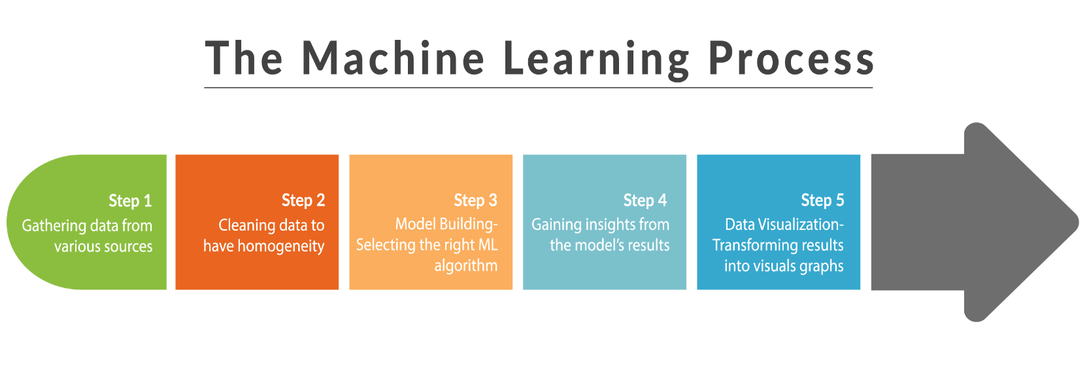
Solution Overview
To build and deploy a recommendation engine that can segment the users on the basis of their propensity to watch a video in the next 2 days, follow the steps below :
Setting the approaches based on the desired goal
Retrieving Data
Data Exploration & Visualization
Building the recommendation engine

Slide 7
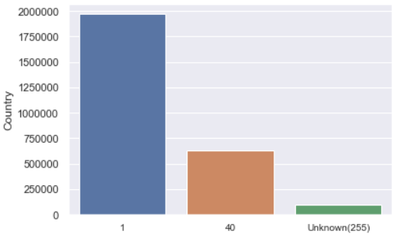
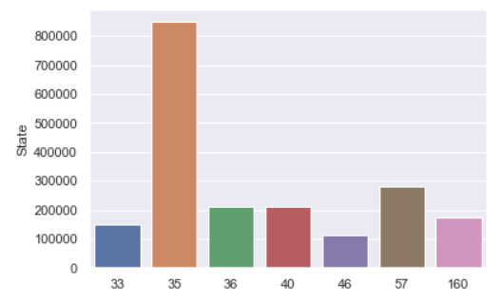
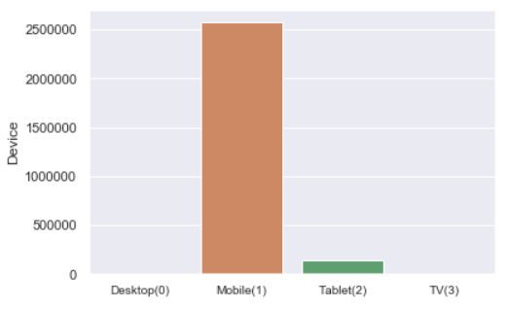
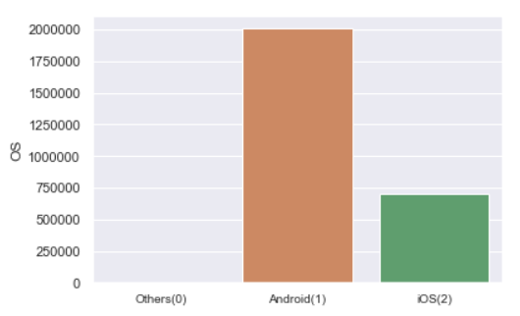
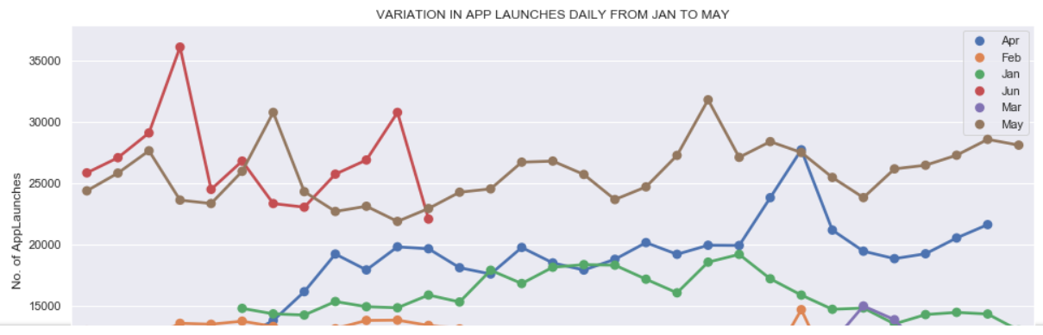
Data Exploration
AppLaunched (Distribution Graphs)

Slide 8
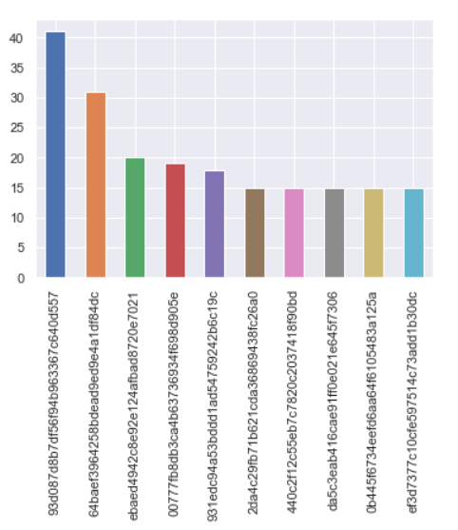
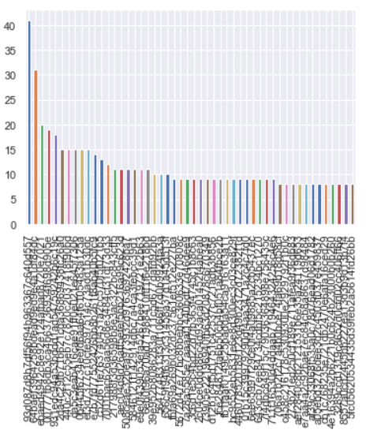
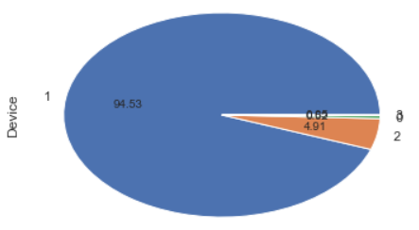
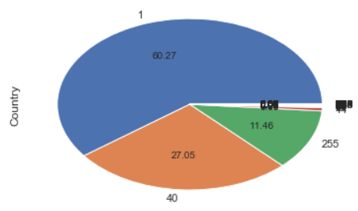
Data Exploration
AppUninstalled (Distribution Graphs)

Slide 9
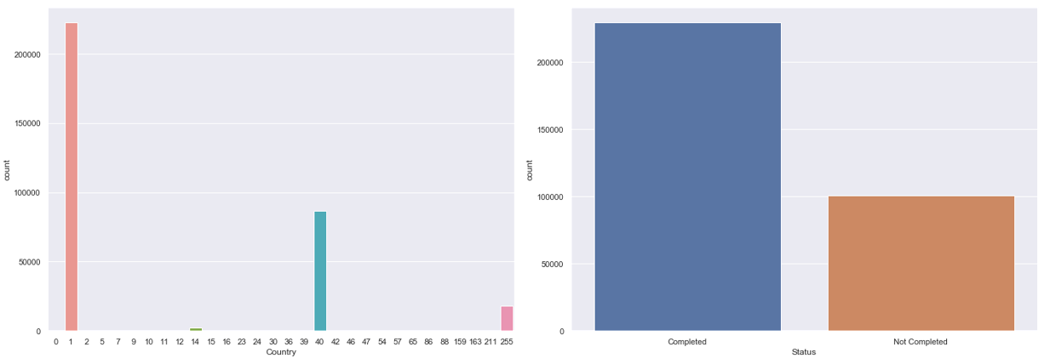
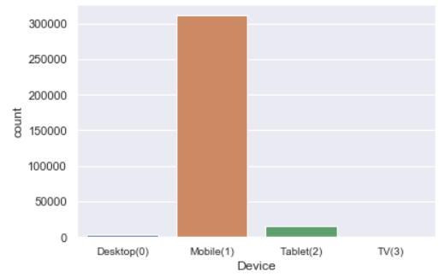
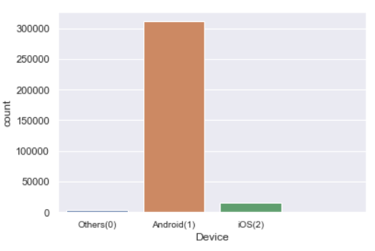
Data Exploration
Registration (Distribution Graphs)

Slide 10
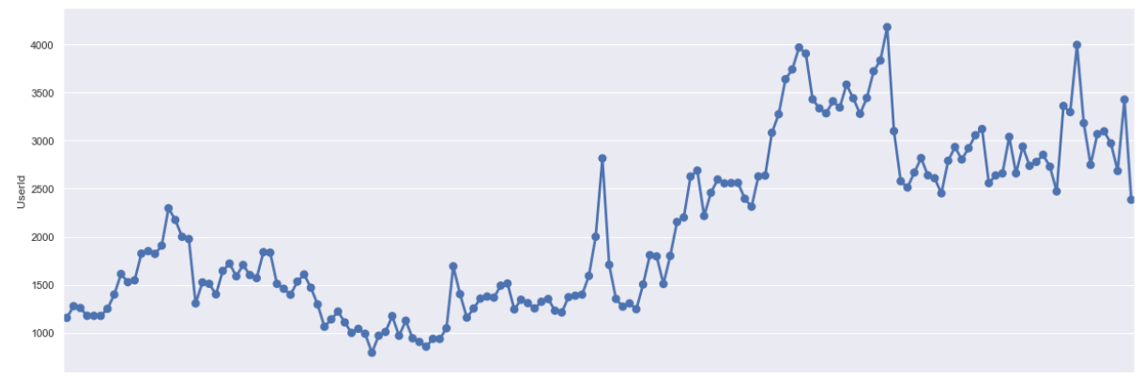
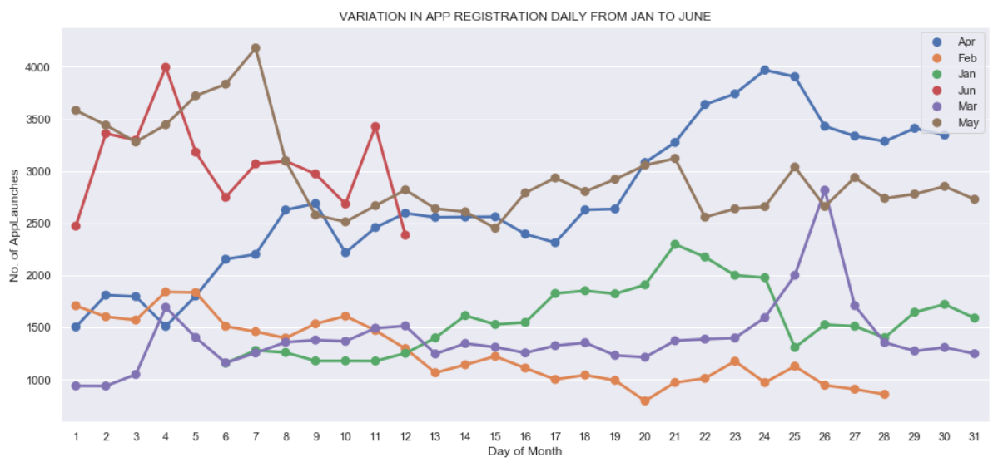
Data Exploration
Registration (Distribution Graphs)

Slide 11
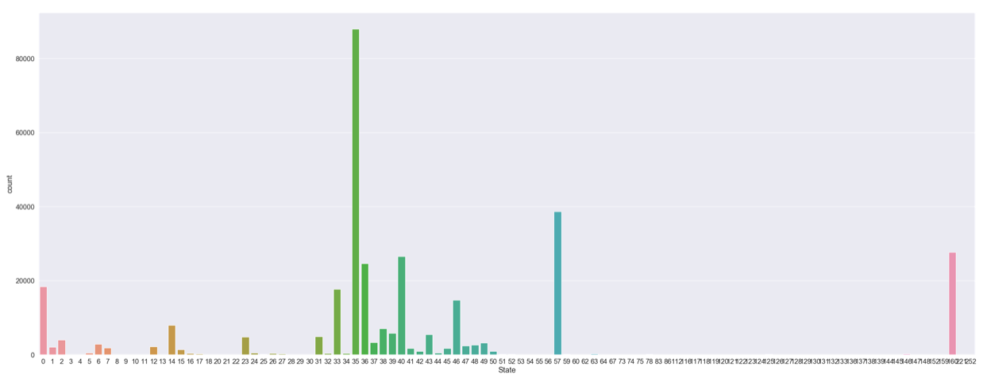
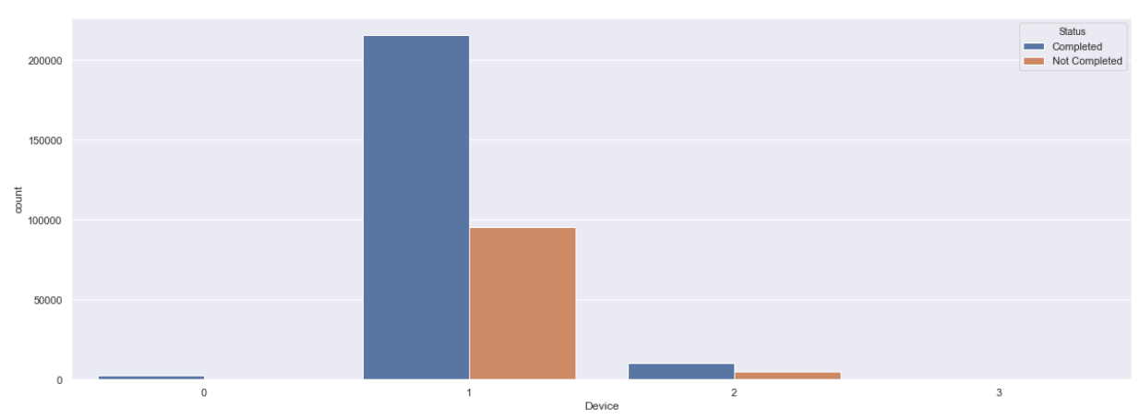
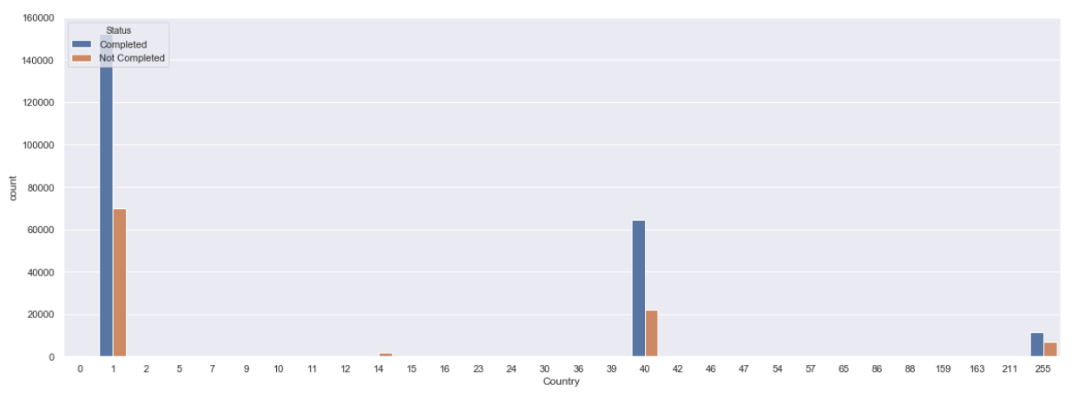
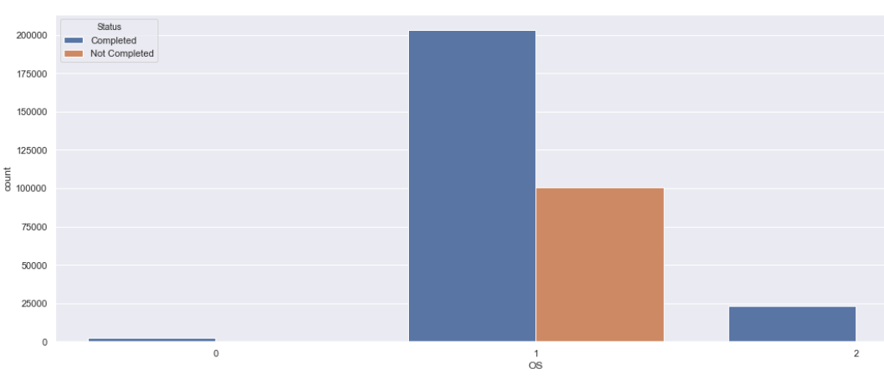
Data Exploration
Registration (Distribution Graphs)

Slide 12
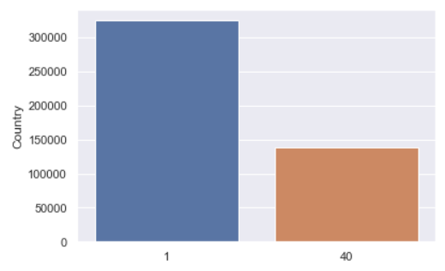
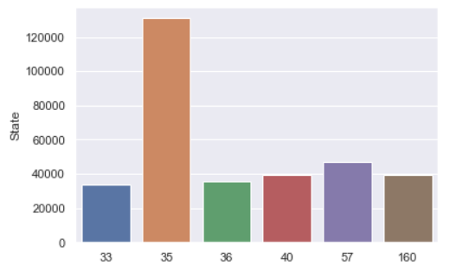
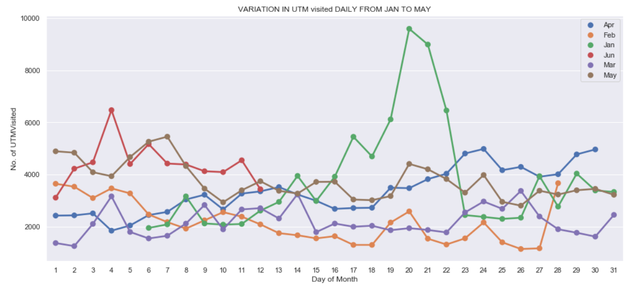
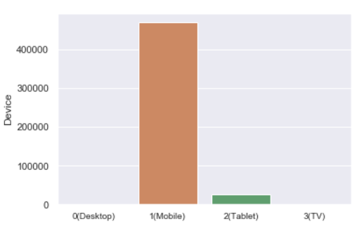
Data Exploration
UTMVisited (Distribution Graphs)

Slide 13
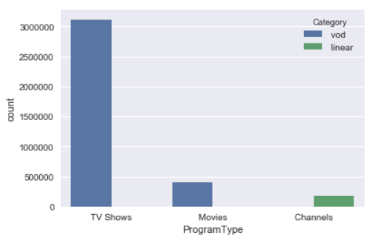
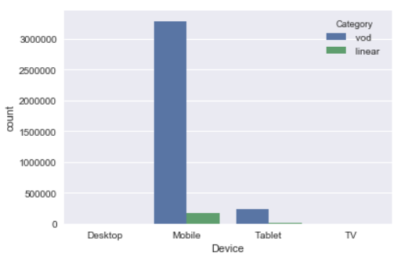
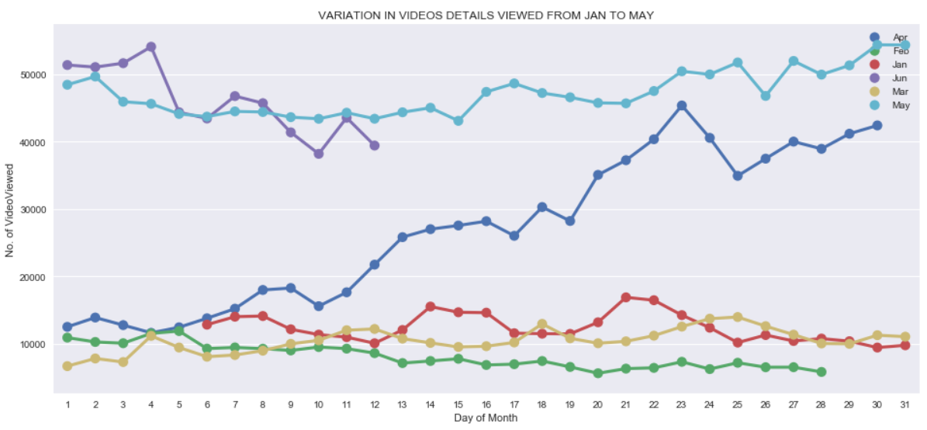
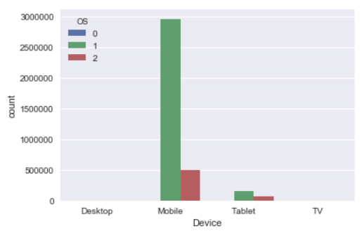
Data Exploration
VideoDetails (Distribution Graphs)

Slide 14
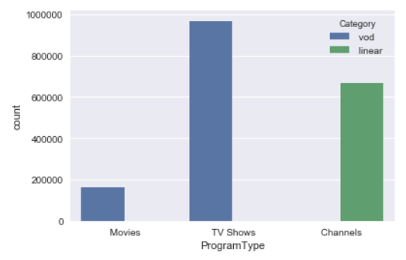
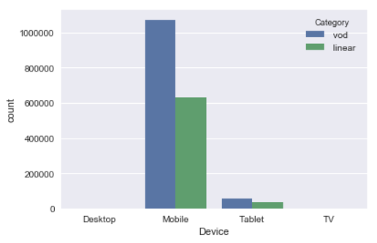
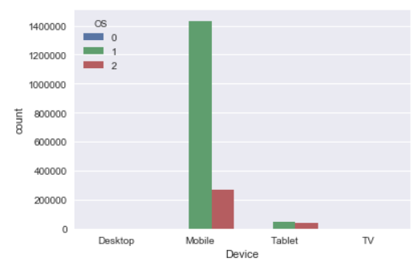
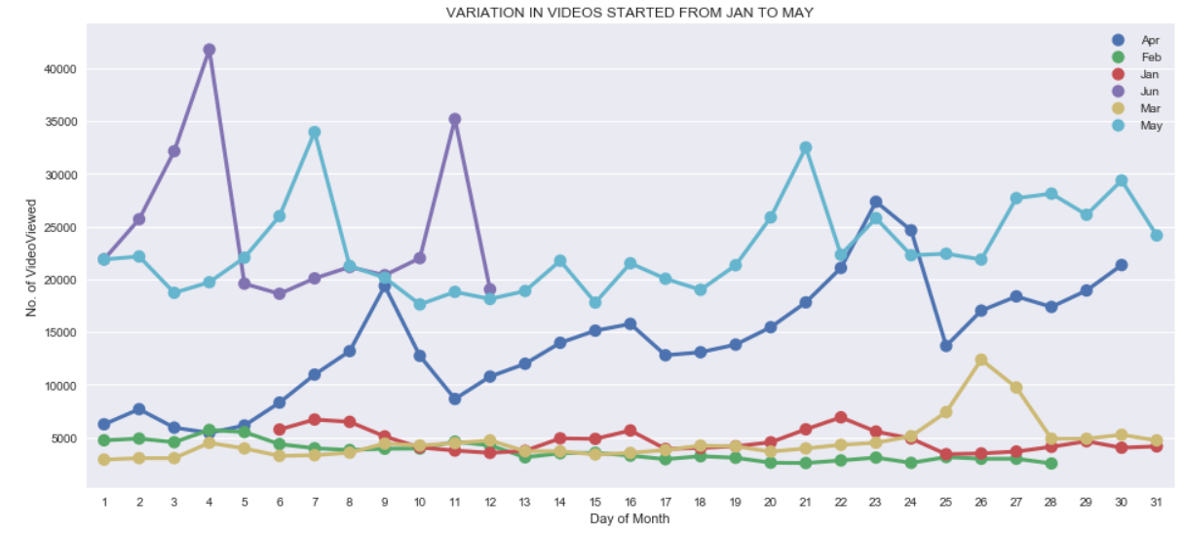
Data Exploration
VideoStarted (Distribution Graphs)

Slide 15
Recency-Frequency Approach To Segment Users

Slide 16
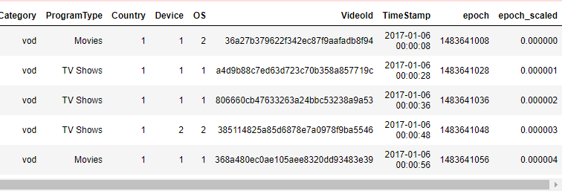
Step 1 Define a column “epoch” as Unix Timestamp

Slide 17
Step 2 Sort DataFrame in ascending order of epoch
Step 3 Pick a date (0.7 quantile for now)

Slide 18
Step 4 Split into train & test
Data before 0.7 quantile
Data after 0.7 quantile

Slide 19
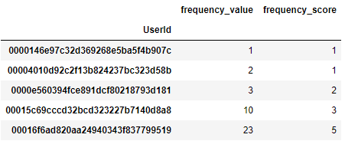
Step 5 For train-data, calculate frequency value & score

Slide 20
How did we do Step 5
Frequency Score | Frequency Value Range
5 | > 22
4 | 10 - 22
3 | 4 – 10
2 | 2 - 4
1 | 1 or 2

Slide 21
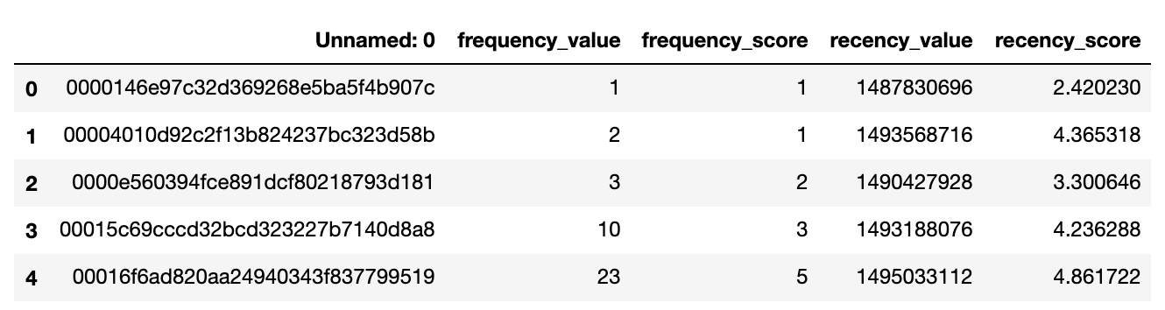
Step 6 For train-data, calculate Recency value & score

Slide 22
Step 7 Define Segments
Segment | Recency Score Range | Frequency Score Range
Champions | 4-5 | 4-5
Loyal Customers | 3-4 | 4-5
Potential Loyalists | 4-5 | 2-3
Promising | 3-4 | 1-2
Can't Lose Them | 1-2 | 4-5
At Risk | 1-2 | 3-4
Hibernating | 1-2 | 1-2
New Customers | 4-5 | 1-2

Slide 23
Step 8 Calculate count of users for segments
Segment | Count in Training Set
At Risk | 4578
Can't Lose Them | 2593
Champions | 18892
Hibernating | 16760
Loyal Customers | 4458
New Customers | 20775
Potential Loyalists | 22843
Promising | 18358

Slide 24
Step 9 Define threshold for calculating f1 score
Category | Score Range
Recency Score | >= 3.89
Frequency Score | >= 4

Slide 25
Step 10 Get test data for 2 days
Data before 0.7 quantile
Data for 2 days after 0.7 quantile

Slide 26
Step 11 Get Classification Reports
Metric | Value
Precision | 0.41
Recall | 0.18
F1-score | 0.25

Slide 27
Recency-Frequency Analysis
Possible Improvements:
Video’s Genre-wise Frequency calculation.
Defining thresholds using Learning Algorithms.

Slide 28
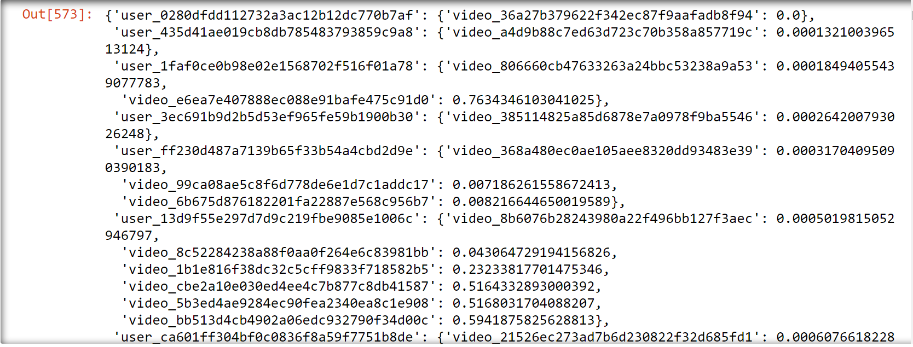
Recommendation Engine
Data Manipulation :
Created a Timestamp for the time a video was watched.
Converted it to epoch time.
Created a dictionary of unique users and the videos they have watched along with the epoch time when they watched the video.

Slide 29
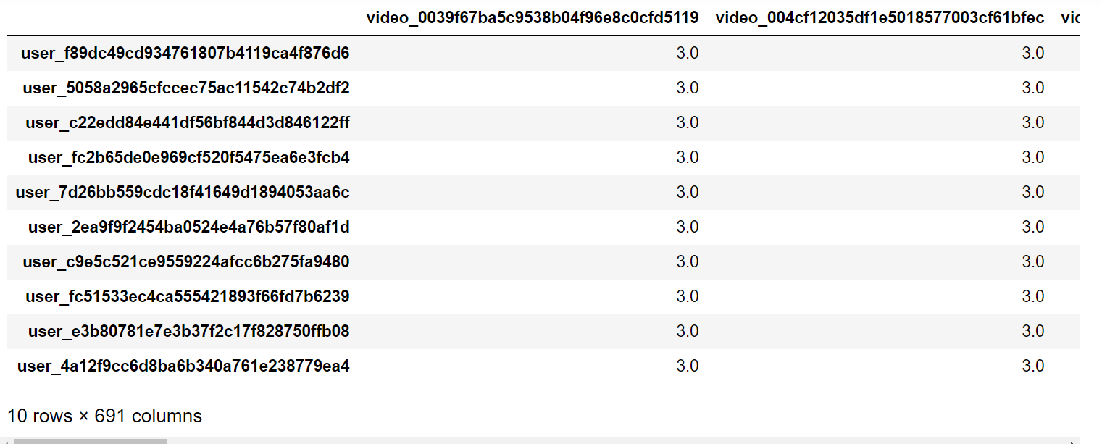
Recommendation Engine
Vectorize the Data
If a user has watched a video we use the scaled value of epoch time as the value, else if a user has not watched a video assign a integer greater than 2. (we have used 3)

Slide 30
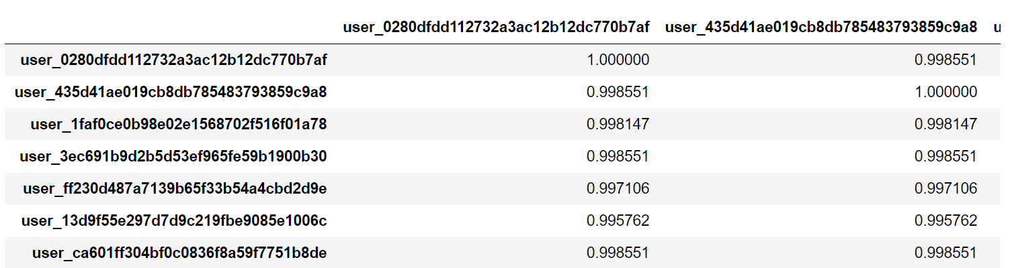
Recommendation Engine
User Based Collaborative Filtering
Finding the similarity between users using cosine similarity.

Slide 31
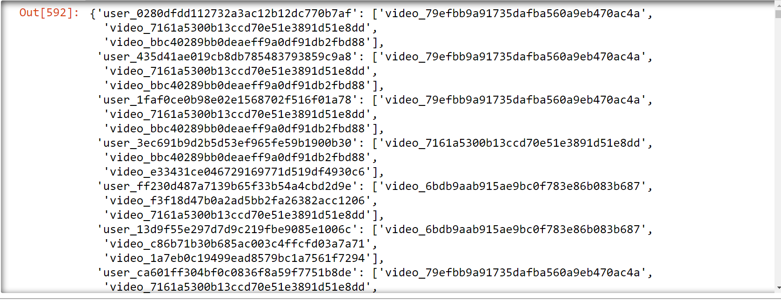
Recommendation Engine
Find the top 10 nearest neighbors and recommend 3 videos that the target user has not watched but the neighbors have watched in the given time frame.

Slide 32
Recommendation Engine
Possible Improvements:
Use item based collaborative filtering for faster predictions.
Use the RF- score calculated earlier to rank the recommendations according to the users they are coming from.

Slide 33

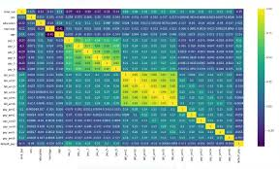


DS & ML – Capstone Project

Slide 34


Capstone Project Team : Clyde M., Krupa S., Pranav N., Rushabh M. & Rajesh B.

